Slide 1
Managing VMware Environments with HashiCorp Vault

Slide 2


Gabe Maentz
Work @ RiverPointTechnology.com
Tweet @ gmaentz
Blog @ Maentz.net
Code @ github/gmaentz
Co-Founder @ vBrisket.com

Slide 3
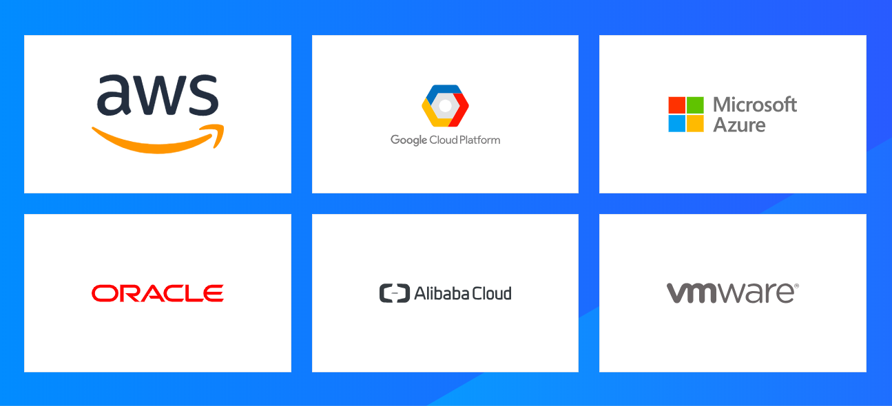
Customers are Adopting Cloud
Notes:
All major cloud providers (private and public) were present at the conference – many with new announcements in how they are integrating, and in many cases using the HashiCorp products within their ecosystem.
I know there are a number of folks in the audience utilizing VMware in their private data centers…..can I get a quick show of hands?
How about AWS users? GCP? Azure?
Oracle / Allibaba
Any not represented on this slide?

Slide 5
But the Reality is ….. Enterprises are Running Data Centers
Notes:
All major cloud providers (private and public) were present at the conference – many with new announcements in how they are integrating, and in many cases using the HashiCorp products within their ecosystem.
I know there are a number of folks in the audience utilizing VMware in their private data centers…..can I get a quick show of hands?
How about AWS users? GCP? Azure?
Oracle / Allibaba
Any not represented on this slide?

Slide 6
And those Enterprises…. are running VMware
“Most of the World is virtualized running VMware”
Andy Jassy
CEO Amazon Web Service
AWS re:Invent 2018
Keynote
Notes:
All major cloud providers (private and public) were present at the conference – many with new announcements in how they are integrating, and in many cases using the HashiCorp products within their ecosystem.
I know there are a number of folks in the audience utilizing VMware in their private data centers…..can I get a quick show of hands?
How about AWS users? GCP? Azure?
Oracle / Allibaba
Any not represented on this slide?

Slide 7
But Maybe Not That Securely
How many VM admins utilize the same root password for all of their ESXi servers?
When was the last time you updated the root password for your ESXi servers?
Do old VM admins who have left your organization still have your root passwords memorized?
Notes:
All major cloud providers (private and public) were present at the conference – many with new announcements in how they are integrating, and in many cases using the HashiCorp products within their ecosystem.
I know there are a number of folks in the audience utilizing VMware in their private data centers…..can I get a quick show of hands?
How about AWS users? GCP? Azure?
Oracle / Allibaba
Any not represented on this slide?

Slide 8
Evolving Secrets Management
Manual
Semi-Automated / Scripted
Automated Single Password
Automated Unique Passwords Safely Stored and Versioned
Manual, Use the UI to update the password
Pain Points: Time Consuming, Password is known by one admin, shares it with others
Starting to use tools like PowerCLI,
Automated PowerCLI, possibly REST API to rotate passwords
Pain Points: Password is known by one admin, shares it with others, no versioning
Automated PowerCLI, REST API to rotate passwords, unique password for all hosts, changed dynamically and still allows for manual revoke and updates
Pain Points: Password is known by one admin, shares it with others, password is updated only when administrator has time to run the script, limited versioning

Slide 9
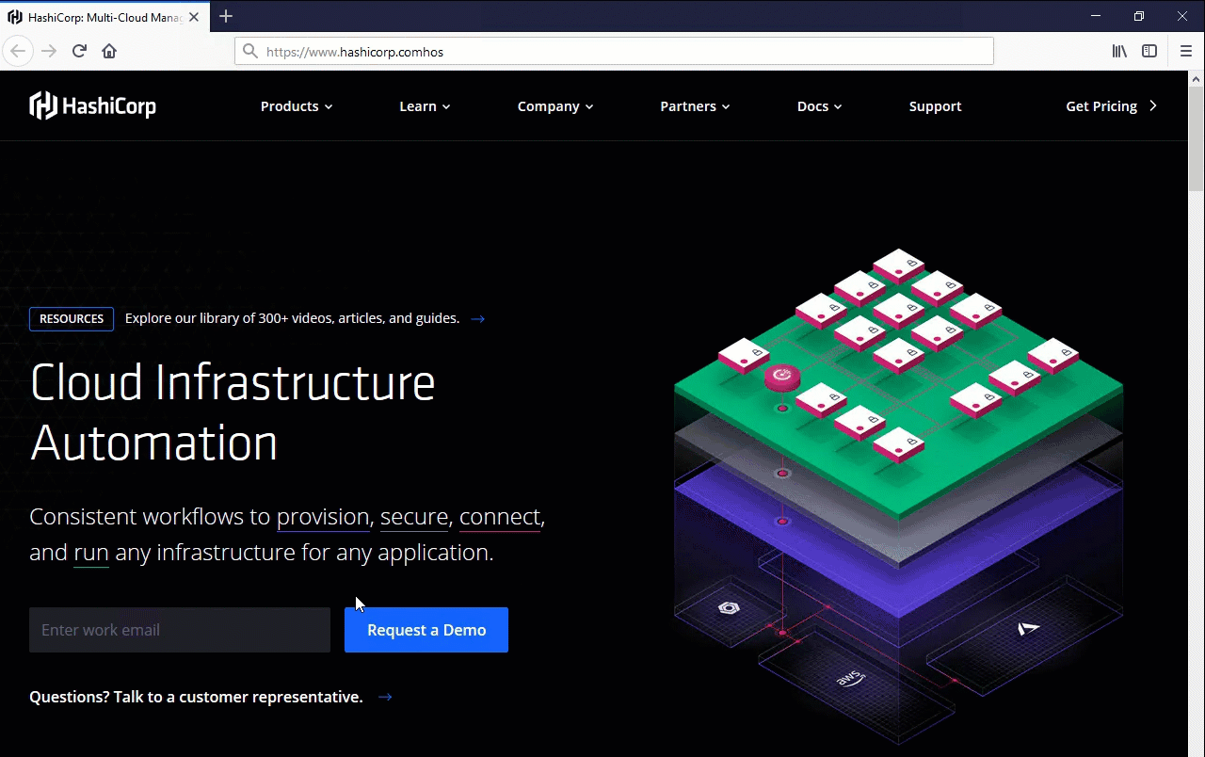
Manual
Use the Web UI or PowerCLI code snippet to update each host individually
Pain Points:
Time Consuming
Password is known by one admin
Socially share it with others

Slide 10

Scripted
PowerCLI
Central login to vCenter
Host inventory managed by vCenter
Pain Points:
Password is known by one admin
Password is updated only when administrator has time to run the script
Limited to no versioning

Slide 11
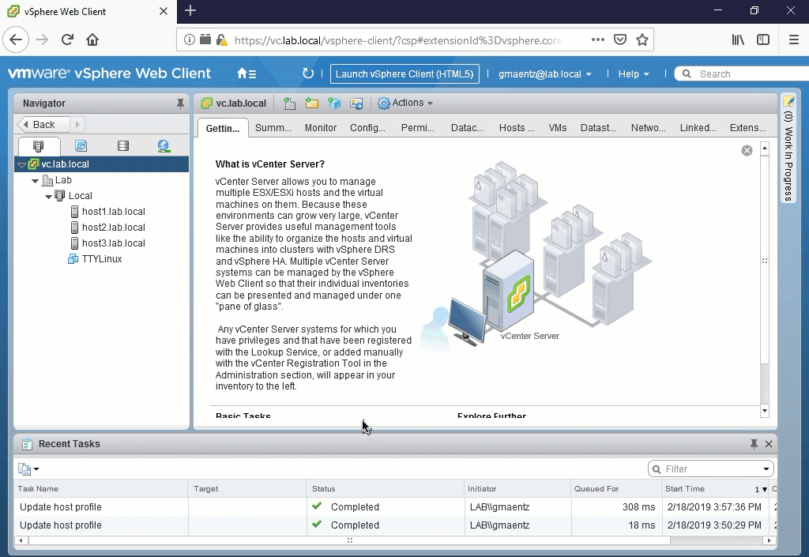
Host Profiles
VMware Host Profiles
Uniform password across Hosts
Can Manage Separate Host Profiles per cluster/host
Pain Points:
Password is known by one admin
Managing Host Profiles
Host Profiles requires VMware Enterprise Plus licensing
Limited to no versioning

Slide 12
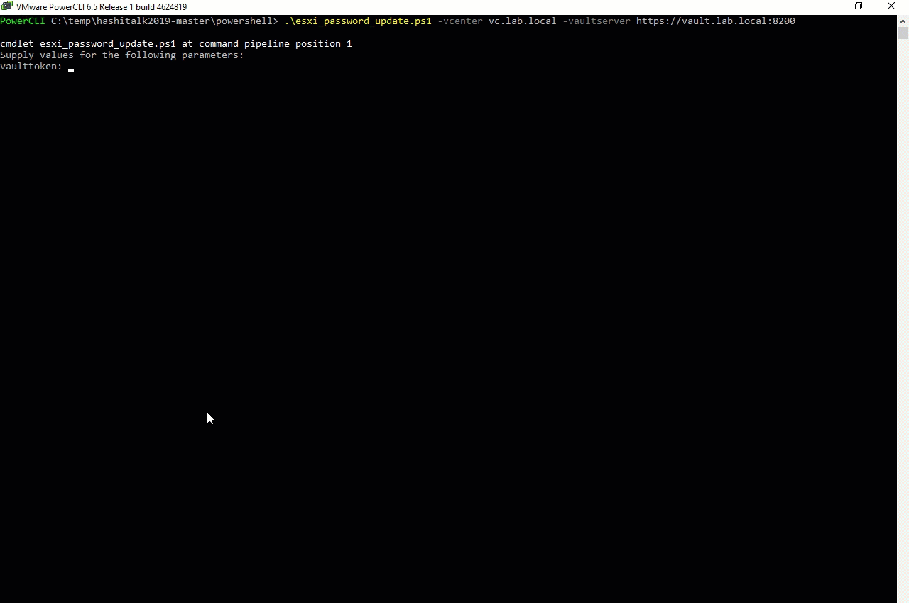
VMware & HashiCorp Vault
Discovery of ESXi hosts using PowerCLI
Integrates with trusted identities (Microsoft AD)
Access root password for each ESXi host using Vault REST API & Policy based access
Generate unique passwords per host and store securely with Vault
Version Passwords within Vault

Slide 13
Vault’s Pluggable Architecture
LDAP / Active Directory
Auth
(Identity)
Secrets
vCenter
ESXi Hosts
Vault
ESXi Password
(Key Value)
Audit
Splunk
ELK
Syslog

Slide 14

Need an ESXi Password? Don’t Ask Gabe, Ask Vault

Slide 15
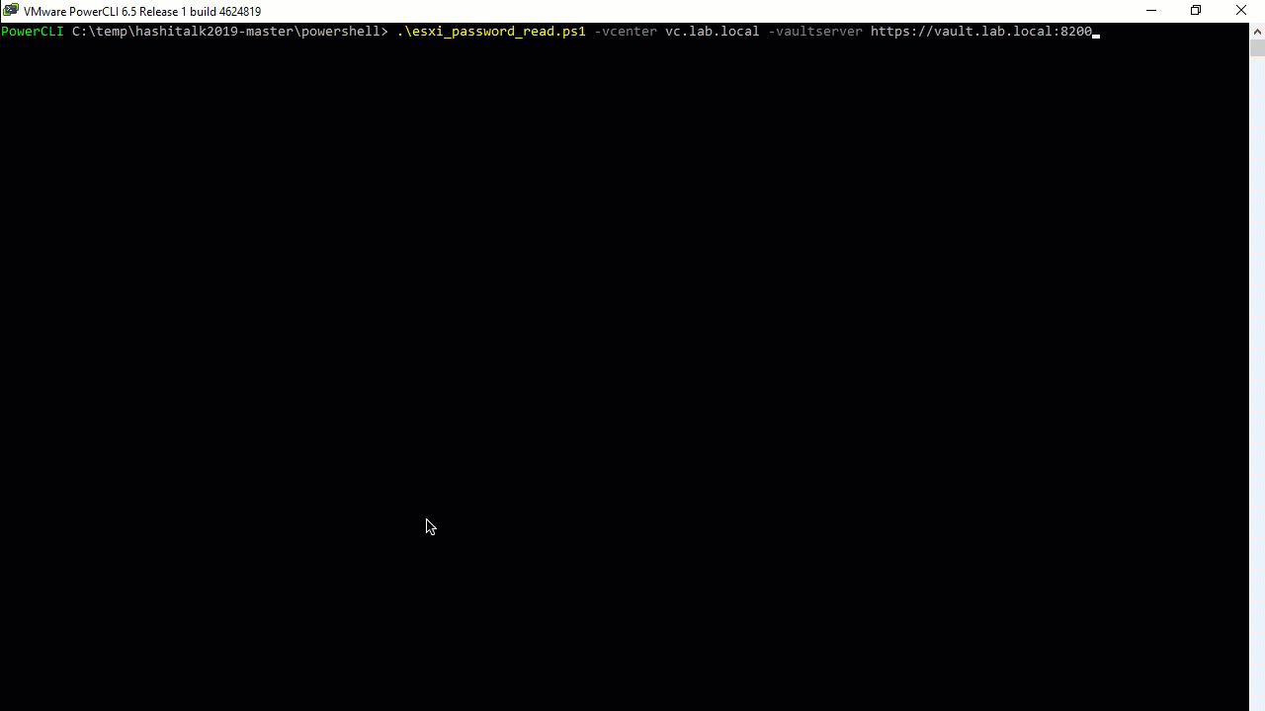
VMware & HashiCorp Vault
Discovery of ESXi hosts using PowerCLI
Integrates with trusted identities (Microsoft AD)
Access root password for each ESXi host using Vault REST API & Policy based access
Generate unique passwords per host and store securely with Vault
Version Passwords within Vault

Slide 16
Reference Items
Slide Deck, Code & Config - https://github.com/gmaentz/hashitalk2019
VMware PowerCLI - https://my.vmware.com/web/vmware/details?downloadGroup=PCLI650R1&productId=614
HashiCorp Vault - https://www.vaultproject.io/
River Point Technology - http://www.riverpointtechnology.com/

